Slide 1
Accelerating records management at CERN
Andrew Short
andrew.short@cern.ch

Slide 2
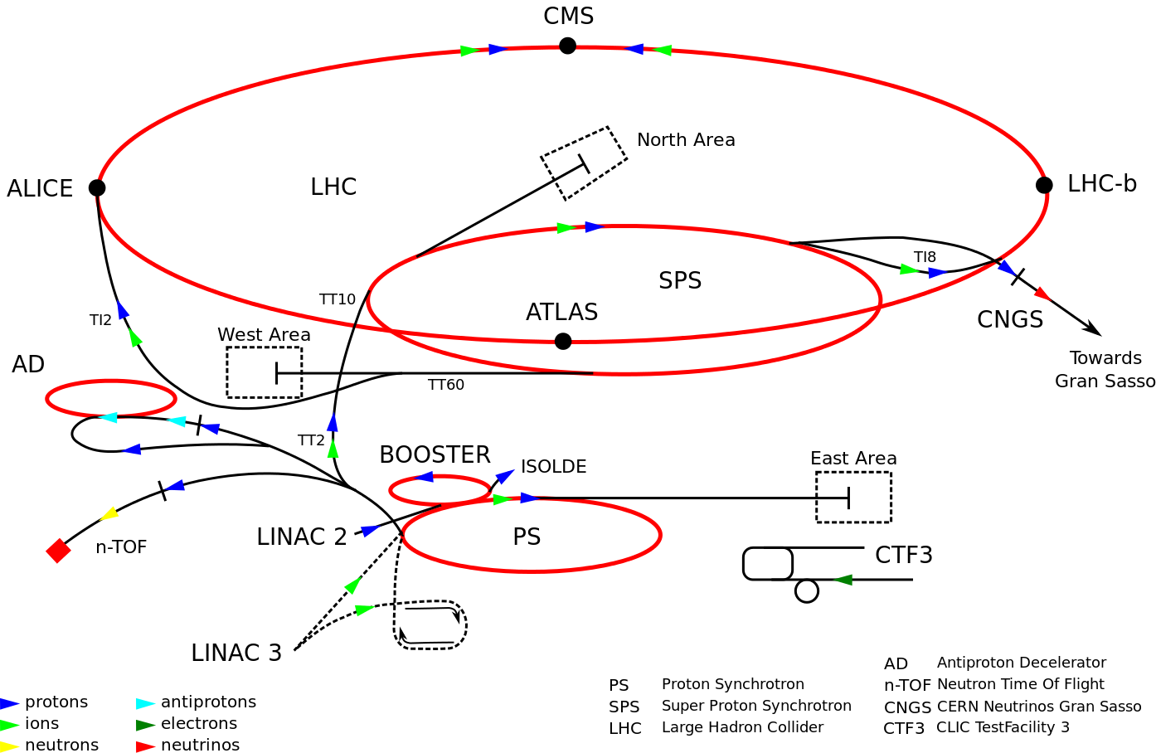
CERN Accelerator Complex

Slide 3
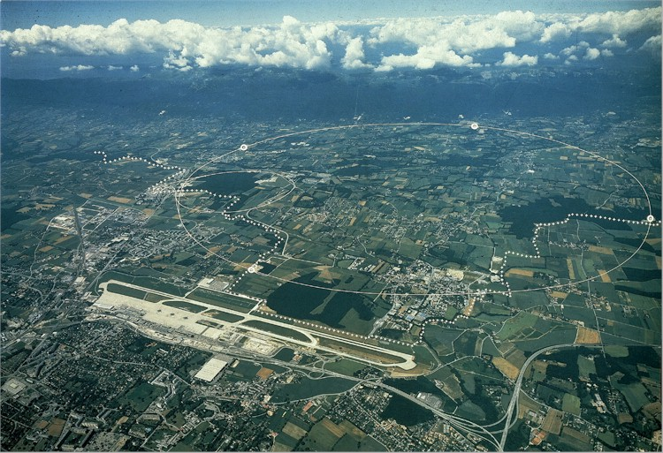
CERN Accelerator Complex

Slide 4
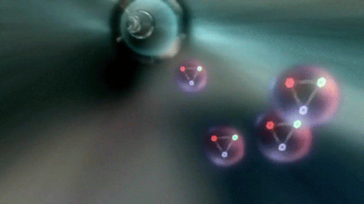
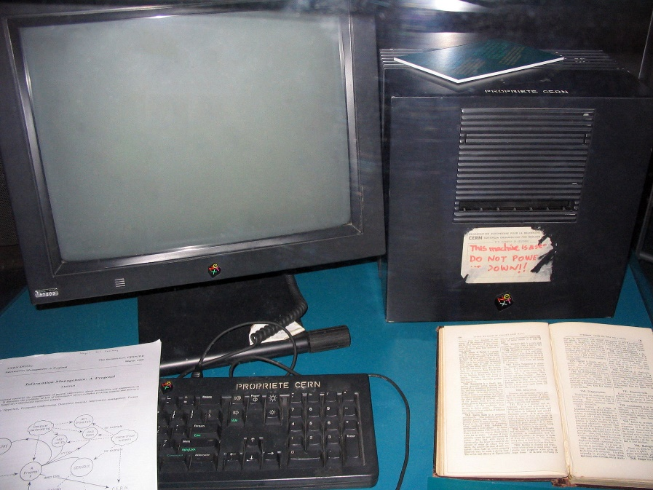
CERN
Worlds biggest machine
Hottest, coldest & emptiest place in the solar system
100,000 hotter than the sun
271.3°C (1.9 K) colder than outer space
10x less than the pressure on the Moon
Fastest race track on the planet
99.9999991% the speed of light
Most powerful supercomputer in the world
Using the grid
Where the web was born

Slide 5

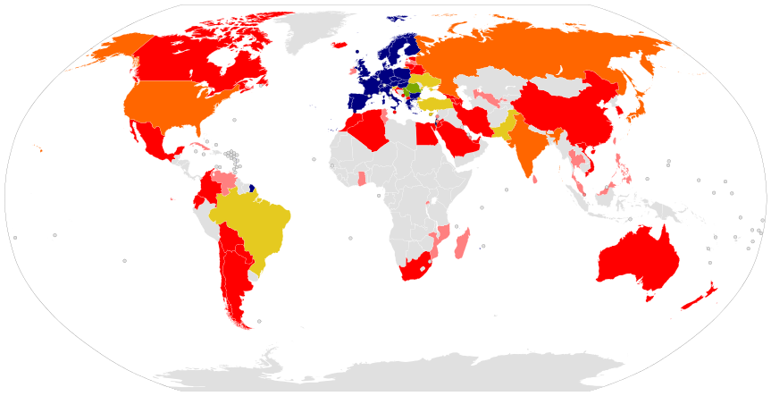
CERN Members of Personnel
2,500 Staff
~1,600 Other personnel
12,000 Visiting scientists
608 Universities
127 Nationalities
21 Member states of CERN

Slide 6

CERN Members of Personnel
2,500 Staff
~1,600 Other personnel
12,000 Visiting scientists
608 Universities
127 Nationalities

Slide 7
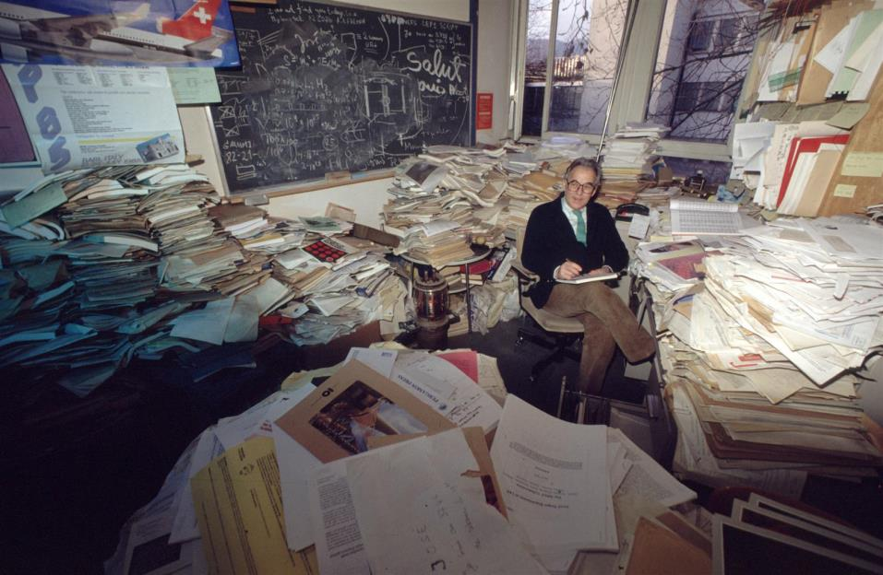
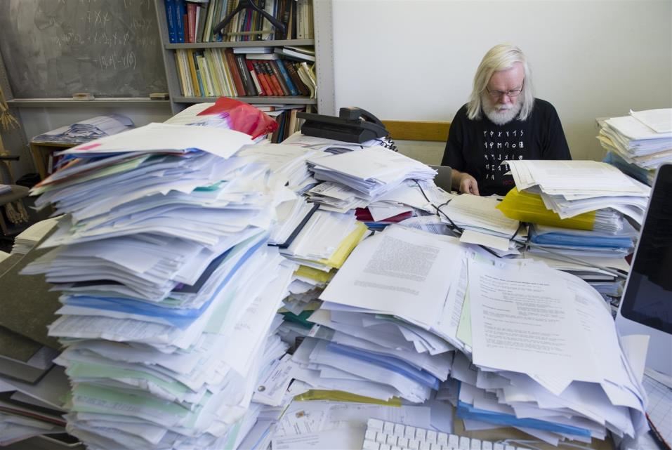
CERN Members of Personnel
Notes:
This is the office of one of our renowned physicists – Mr Dick, among his scientific papers
One of the leading theoretical physicists of CERN, retired Professor Dick works in his office. Despite the look of his office, he is still the master of his universe. His individual stacking order is world famous since he only needs a maximum of 5 seconds to find ANY paper in his office. Many colleagues used his 'filing' method to shortcut their own search for publications.
http://www.gettyimages.ch/detail/foto/portrait-of-professor-dick-leading-theoretical-stock-fotografie/57191917
2) this is the office of Professor John Ellis another one of our celebrated physicists. LEP, LHC, CLIC,
More on Ellis: https://en.wikipedia.org/wiki/John_Ellis_(physicist)

Slide 8
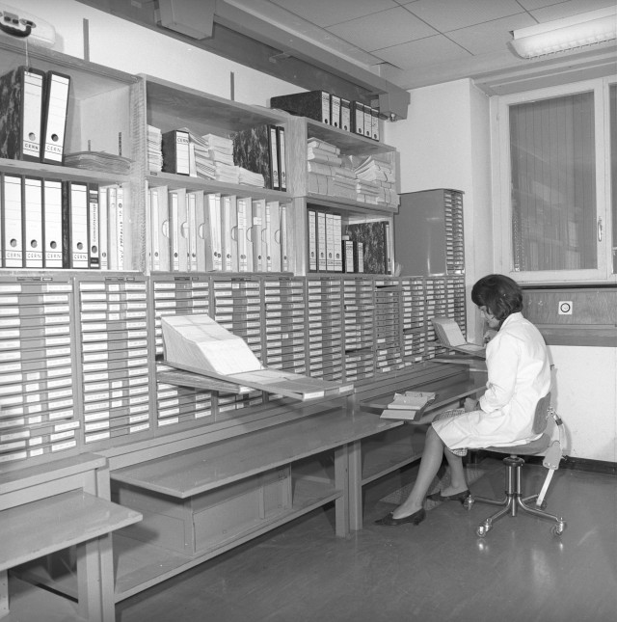
Records Office - Then
Records Office 1965
CERN PhotoLab, 1978
Store all personnel records
Initially on a single card, then folders
Personnel records grew quick.
Paper index file to retrieve personnel file.

Slide 9
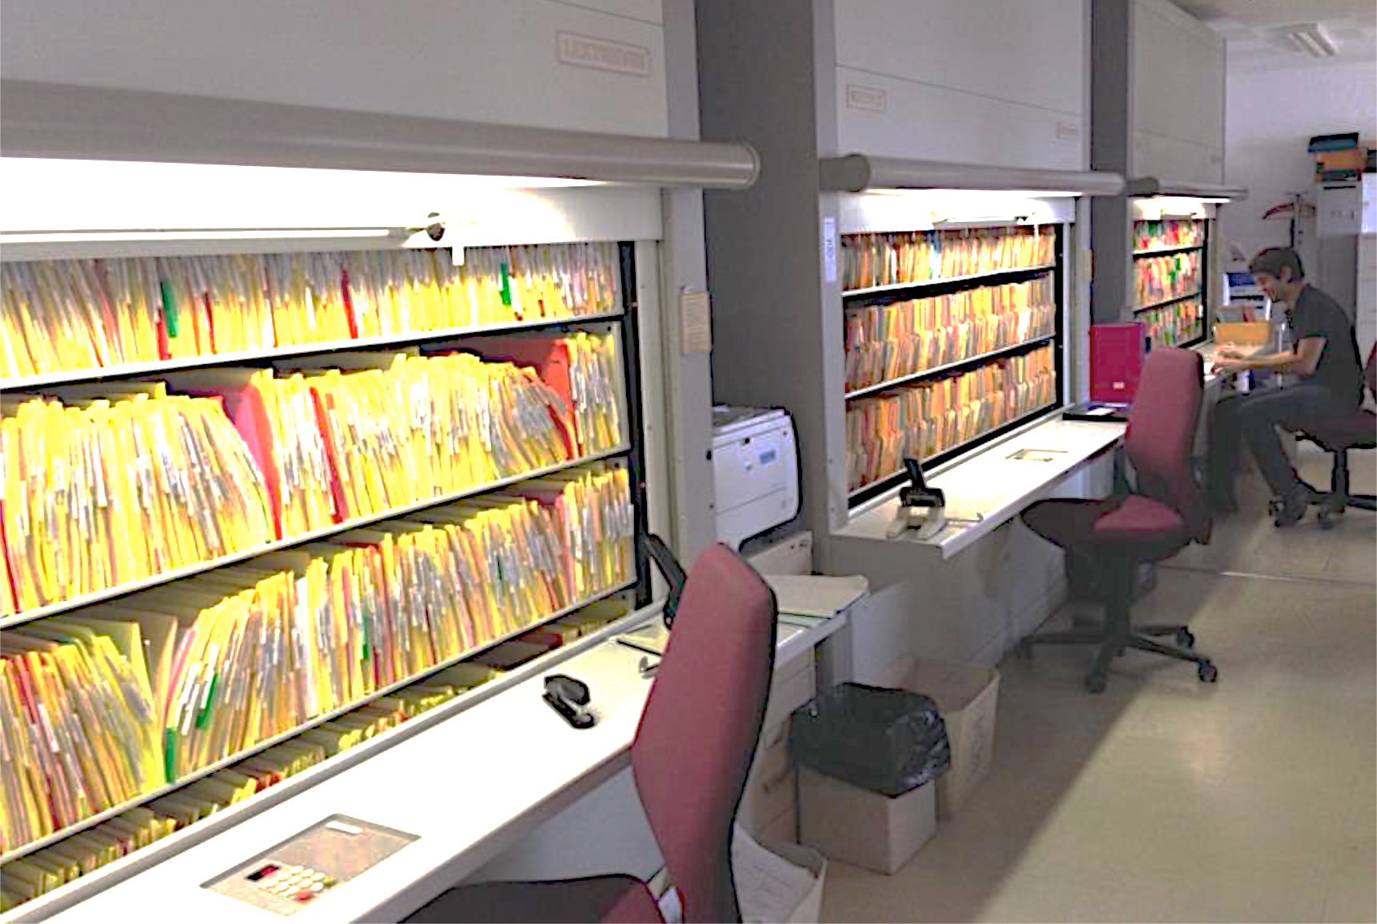
Records Office – 2015
Automated Kardex machines
Started scanning of active personnel files
Started collecting new documents as PDF’s only
Using naming convention (DOCID;CERNID;INITIALS; EFFECTIVEDATE)
Changes in organisation workflows
Temporarily emailing documents between services (rather than internal mail)
Scanned over 3,000 personnel files

Slide 10
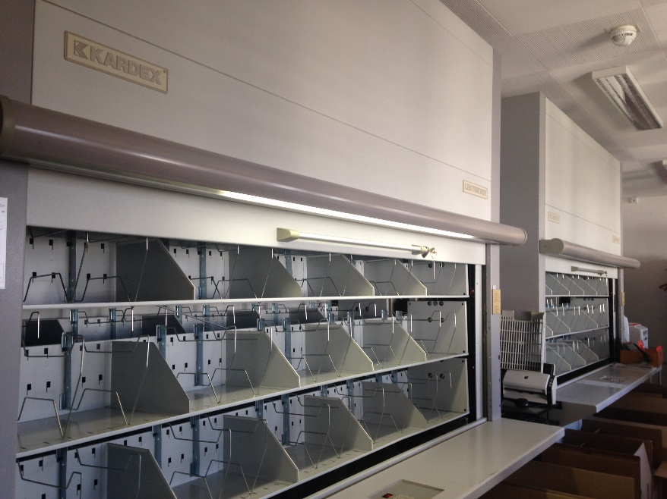
Records Office – 2016
Using eFiles since 4th May
Uploading active personnel files
Easily store and retrieve documents
Saves time and resources
No more printing and mailing documents
Process related improvements
Uploaded over 72,000 documents

Slide 11

Recruitment Unit
Upload documents to Alfresco
Share files with Records Office
Documents injected to Alfresco from recruitment tool (eRT)
Currently injected over 52,000 documents from eRT (April 2016)

Slide 12

Electronic Document Handling
Existing Electronic Document Handling tool (EDH)
Documents to be injected to Alfresco automatically.
Over 18,000 distinct users (2015)
Over 70 document types
Currently holds 6.4 million documents (April 2016)

Slide 13

AISMedia
Existing Electronic Document Storage application
Documents to be injected to Alfresco.
Over XXXX document types
Currently about XXXX documents stored

Slide 14
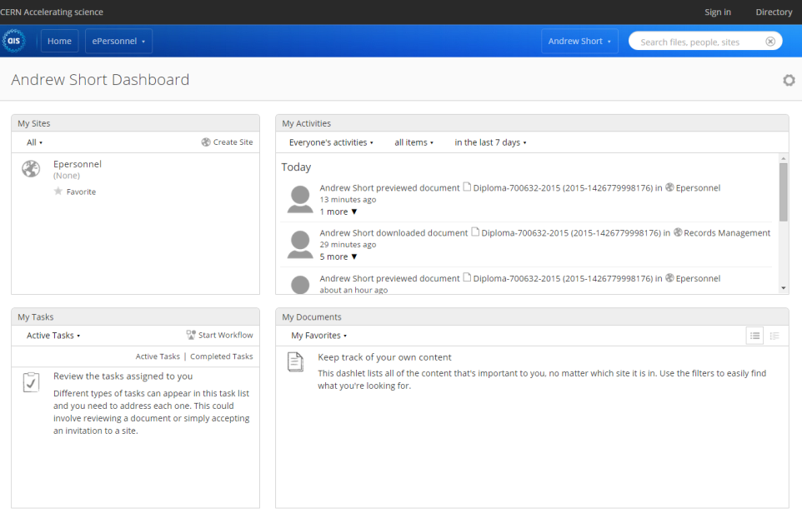
Notes:
Dashboard widgets, customisable, any French speakers in?

Slide 15
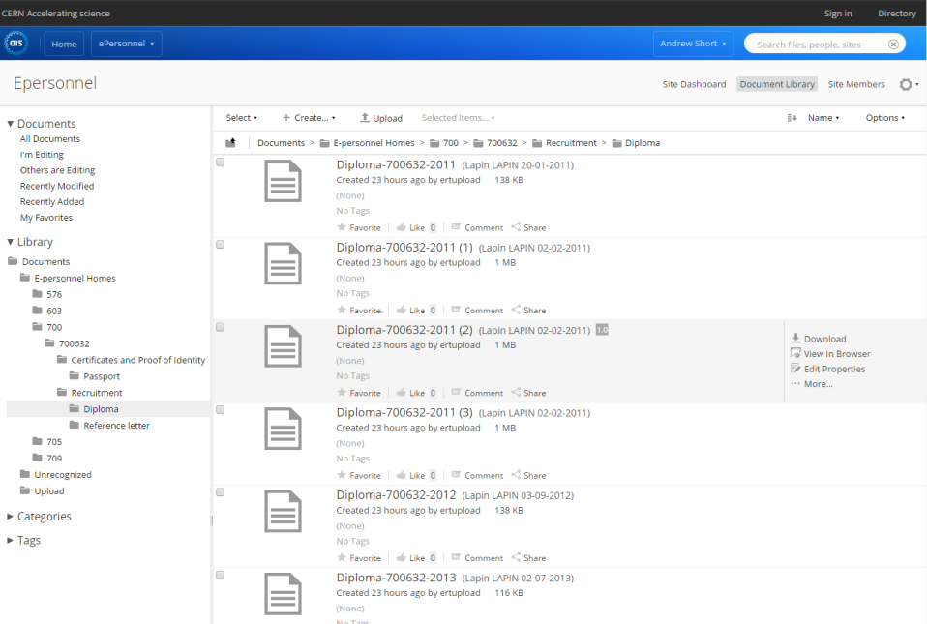
Notes:
File plan

Slide 16
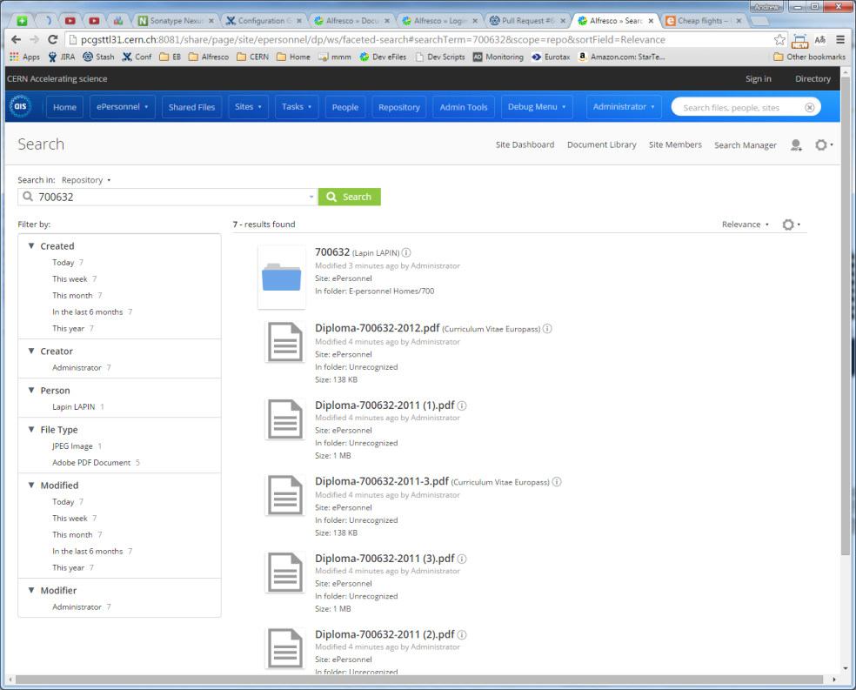
Notes:
Search view

Slide 17
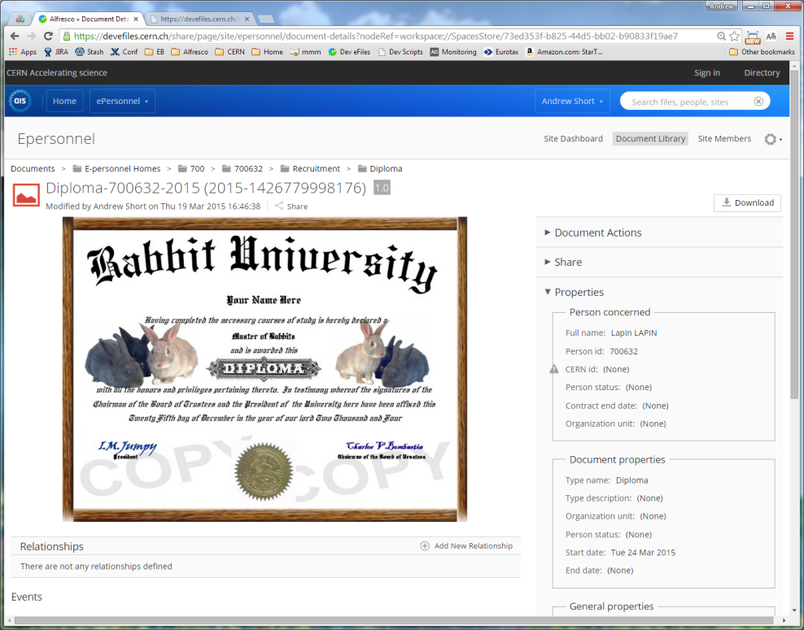

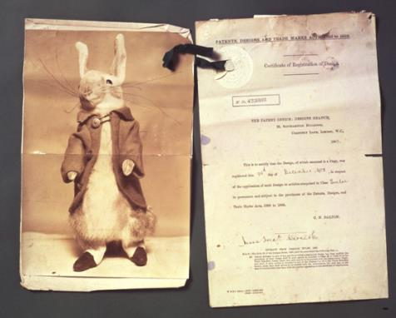

Notes:
Document view

Slide 18

How?
Identify existing organisation documents
Identify document metadata
Identify search requirements
Define file plan
Define access rights
Identify UX customisations
Records management vs Document management
Community or commercial edition
Notes:
Rabbit letter: http://www.vam.ac.uk/users/node/4362

Slide 19
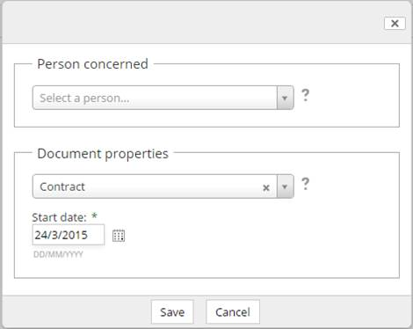
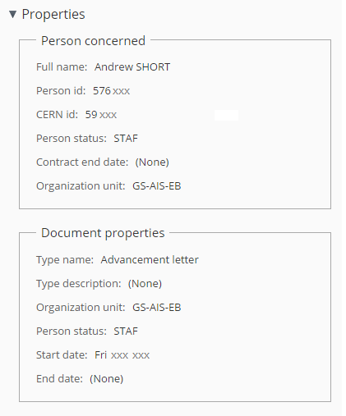
How?
Identify existing organisation documents
Identify document metadata
Identify search requirements
Define file plan
Define access rights
Identify UX customisations
Records management vs Document management
Community or commercial edition

Slide 20
How?
Identify existing organisation documents
Identify document metadata
Identify search requirements
Define file plan
Define access rights
Identify UX customisations
Records management vs Document management
Community or commercial edition

Slide 21
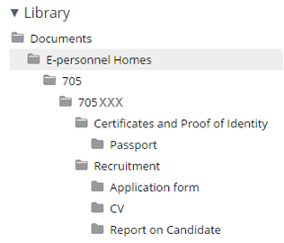
How?
Identify existing organisation documents
Identify document metadata
Identify search requirements
Define file plan
Define access rights
Identify UX customisations
Records management vs Document management
Community or commercial edition

Slide 22
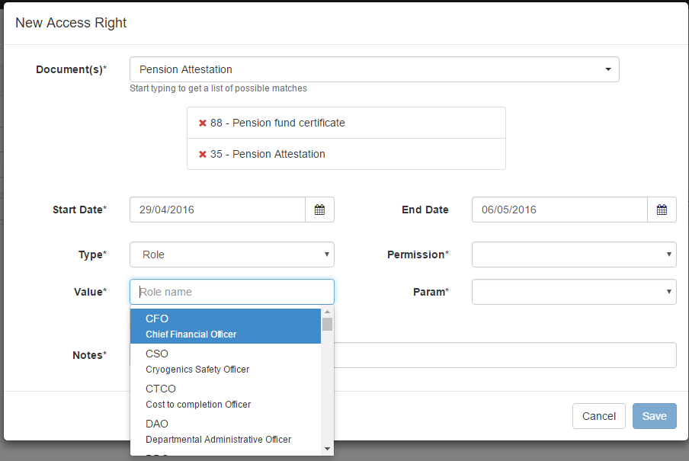
How?
Identify existing organisation documents
Identify document metadata
Identify search requirements
Define file plan
Define access rights
Identify UX customisations
Records management vs Document management
Community or commercial edition

Slide 23
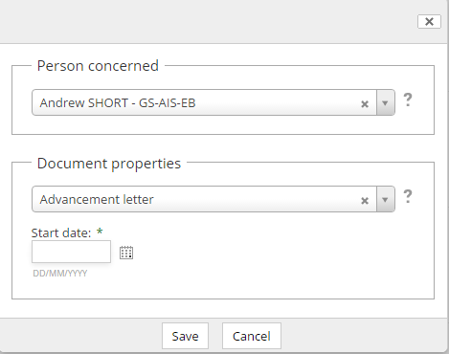
How?
Identify existing organisation documents
Identify document metadata
Identify search requirements
Define file plan
Define access rights
Identify UX customisations
Records management vs Document management
Community or commercial edition

Slide 24
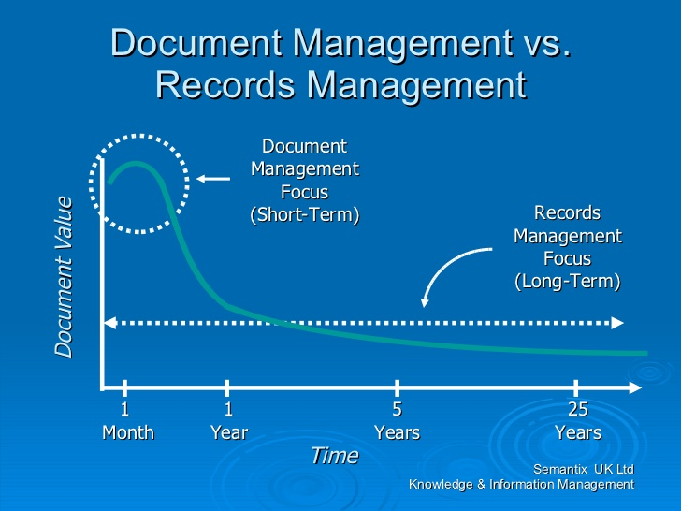
How?
Identify existing organisation documents
Identify document metadata
Identify search requirements
Define file plan
Define access rights
Identify UX customisations
Records management vs Document management
Community or commercial edition
Notes:
Image from:
Information Management Life Cycle by Steve Dale, 22nd Aug 2008
http://www.slideshare.net/stephendale/information-management-life-cycle-presentation

Slide 25
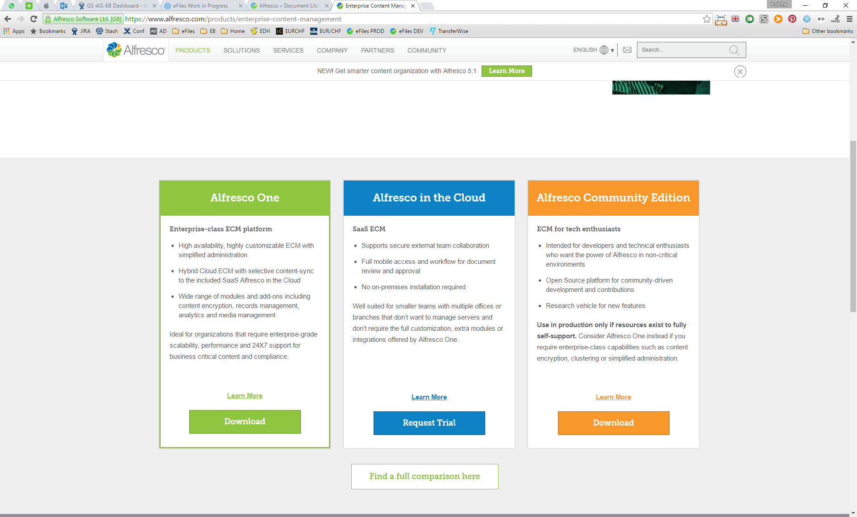
How?
Identify existing organisation documents
Identify document metadata
Identify search requirements
Define file plan
Define access rights
Identify UX customisations
Records management vs Document management
Community or commercial edition

Slide 26
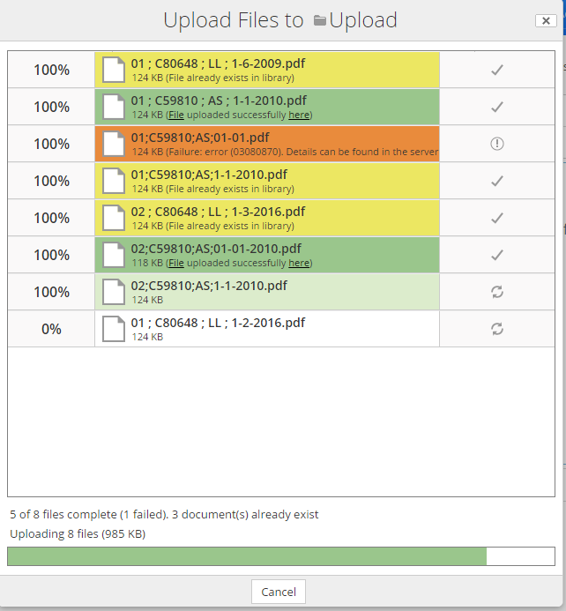
Customisations
Upload
Unrecognised
File plan
Metadata
Access Rights
Monitoring
Admin screens

Slide 27
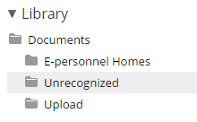
Customisations
Upload
Unrecognised
File plan
Metadata
Access Rights
Monitoring
Admin screens

Slide 28
Customisations
Upload
Unrecognised
File plan
Metadata
Access Rights
Monitoring
Admin screens

Slide 29
Customisations
Upload
Unrecognised
File plan
Metadata
Access Rights
Monitoring
Admin screens

Slide 30
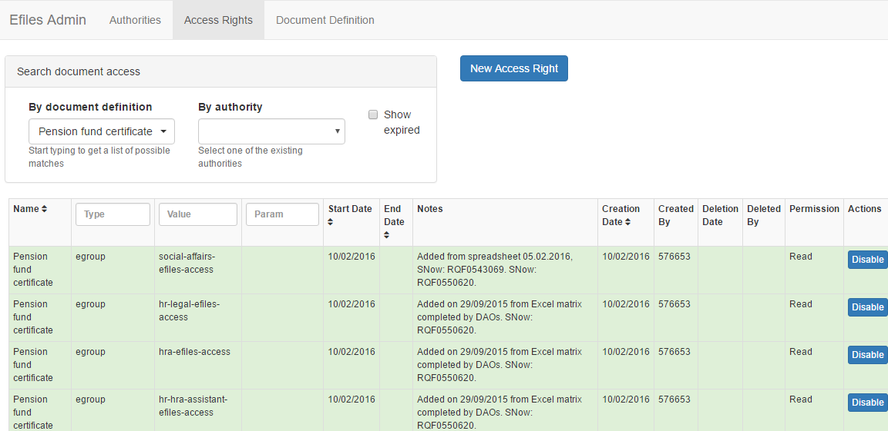
Customisations
Upload
Unrecognised
File plan
Metadata
Access Rights
Monitoring
Admin screens

Slide 31
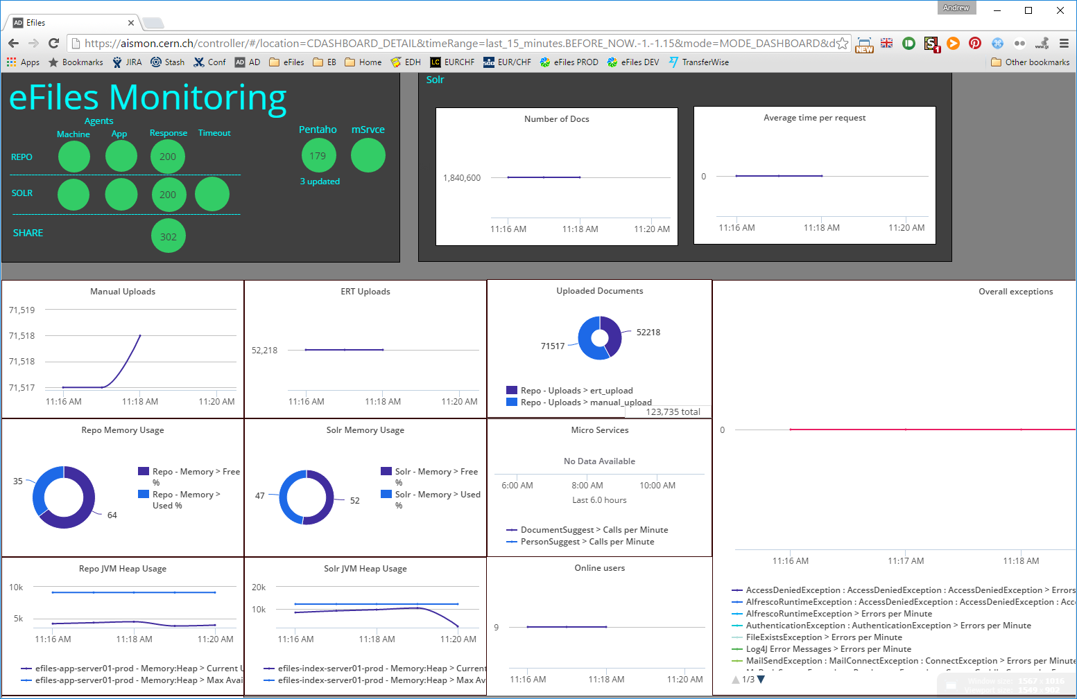
Customisations
Upload
Unrecognised
File plan
Metadata
Access Rights
Monitoring
Admin screens

Slide 32
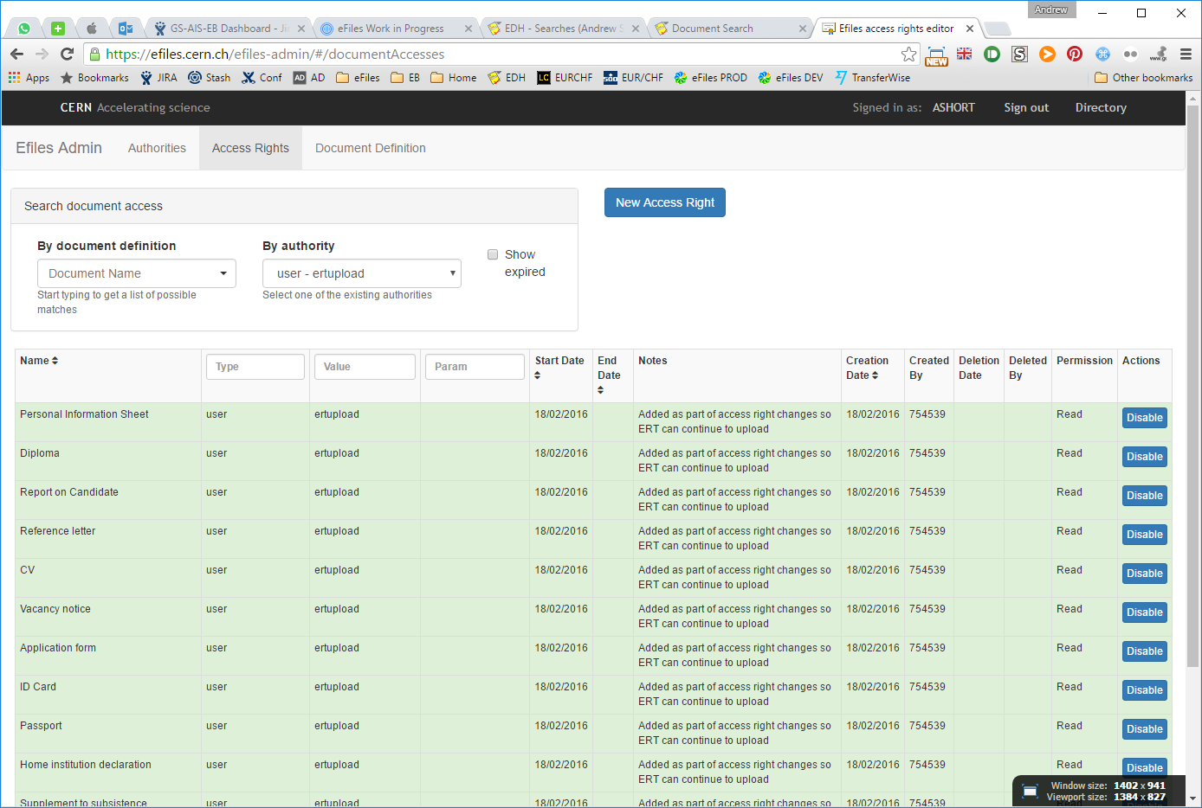
Customisations
Upload
Unrecognised
File plan
Metadata
Access Rights
Monitoring
Admin screens

Slide 33


Next steps
Access Rights
Disposition Schedules
My Files
Workflows
Case Management
Further integration

Slide 34


Next steps
Access Rights
Disposition Schedules
My Files
Workflows
Case Management
Further integration

Slide 35
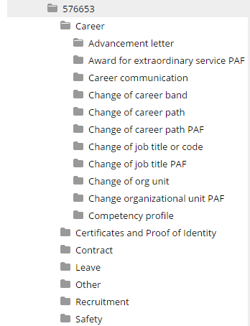

Next steps
Access Rights
Disposition Schedules
My Files
Workflows
Case Management
Further integration

Slide 36
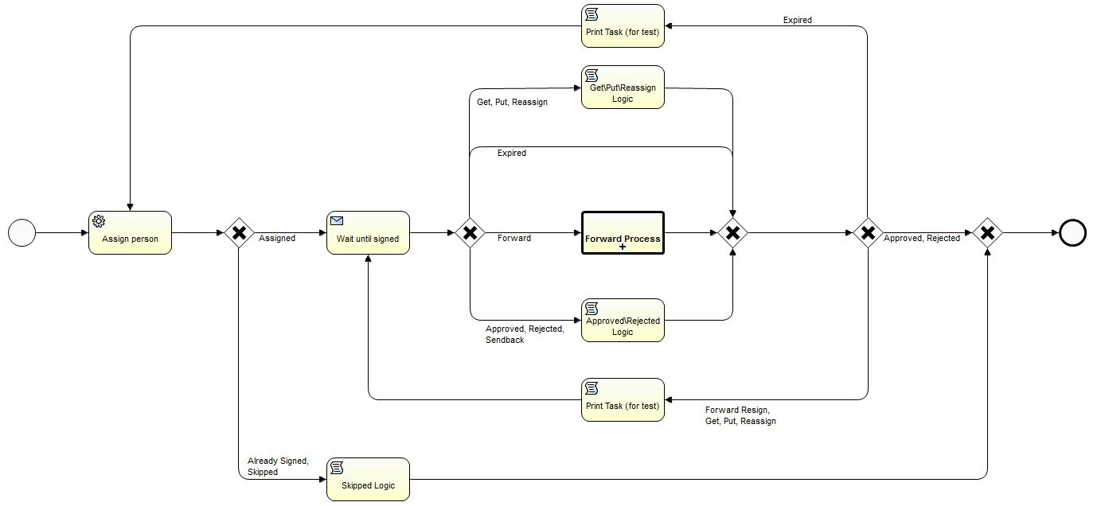
Next steps
Access Rights
Disposition Schedules
My Files
Workflows
Case Management
Further integration

Slide 37

Next steps
Access Rights
Disposition Schedules
My Files
Workflows
Case Management
Further integration
Notes:
Image from: smart-folder-256.png

Slide 38



Next steps
Access Rights
Disposition Schedules
My Files
Workflows
Case Management
Further integration
eFiles
Notes:
DFS: https://www.google.com/url?sa=i&rct=j&q=&esrc=s&source=images&cd=&cad=rja&uact=8&ved=0ahUKEwjn6pn_24bMAhVJ1hQKHXvUCyUQjhwIBQ&url=https%3A%2F%2Fdfs.cern.ch%2F&bvm=bv.119028448,d.ZWU&psig=AFQjCNH0JcqiXYJnhfVwMLyRux-cyvyWLA&ust=1460468680887517

Slide 39



Thank You

Slide 41
Monitoring
Notes:
App Dynamics

Slide 42
Admin Screens
Notes:
Developed using Angular

